Slide 1
Microprocessor Basic Computer Architecture & Cortex-M3 Basics
Seung-Ho Lim
Hankuk University of Foreign Studies

Slide 2
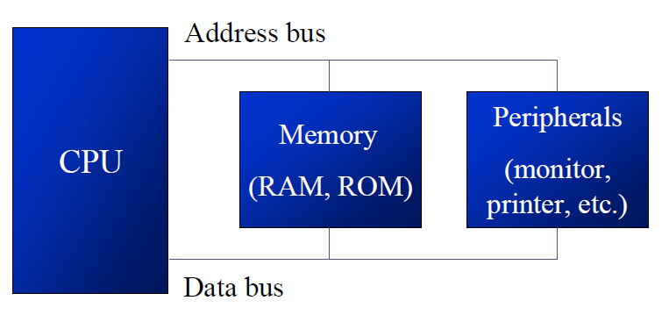
Organization of Computers
CPU (Central Processing Unit)
Execute something stored in memory
Memory
Temporary storage of program and data that CPU executes
I/O (Input/Output) Devices
Provides a means of communicating with CPU

Slide 3
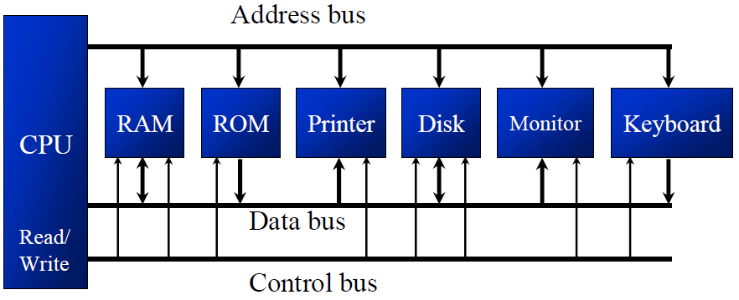
Organization of Computers
The CPU is connected to memory and I/O through strips of wire called bus
Bus carries information from one to another
Address bus
used to assign a specific region or devices
Data bus
Use to transfer data from CPU to others, or vice versa
Control bus
Provides control signal from CPU to others, such as read or write

Slide 4
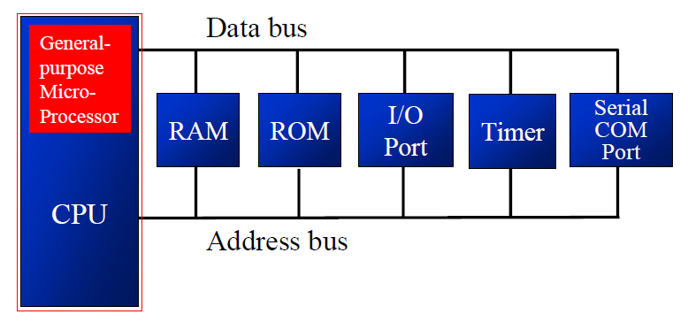
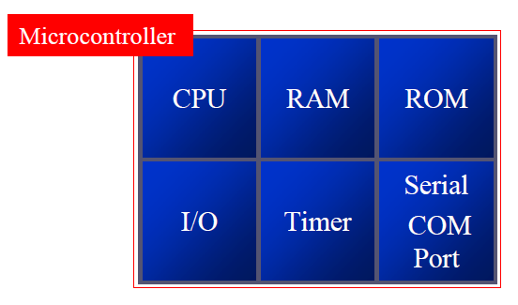
Organization of Computers
(General Purpose)microprocessor VS. microcontroller
GP microprocessor contains only processing unit inside it, and no RAM and other I/O devices
Microcontroller has all in inside it, such as processing unit, RAM, ROM, I/O control units, and so on.

Slide 5
ARM RISC Design Philosophy
Instructions
A fixed size: 32-bit
Executes in a single cycle
Pipelines
Registers
A large general-purpose register set
Load-store architecture
Variable cycle execution for some instructions
LDM/STM, SWP
Thumb 16-bit instruction set
Enhanced DSP instructions

Slide 6
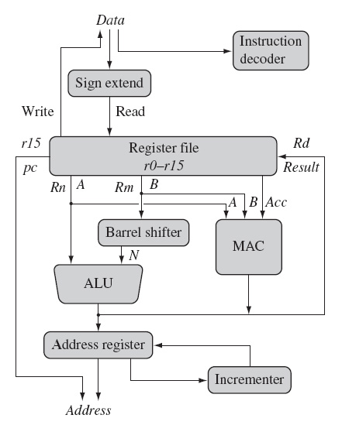
ARM Core Data Flow Model
Arithmetic
Logic
Load
Store

Slide 7
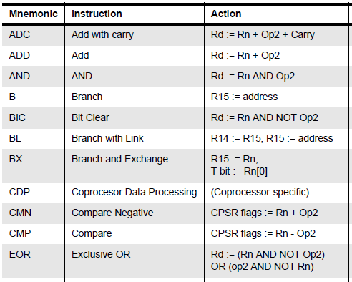
ARM instructions

Slide 8
What is the ARM Cortex-M3 Processor
ARM Cortex-M3 Processor
32-bit microprocessor
Features of ARM Coretex-M3
Greater performance efficiency
Low power consumption
Enhanced determinism
Improved code density
Ease of use
Lower cost solutions

Slide 9
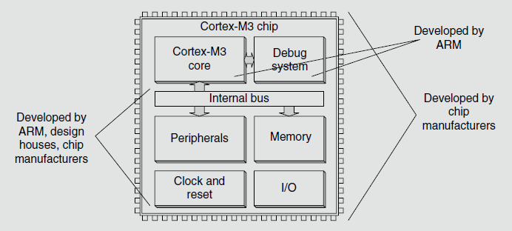
Background of ARM
ARM was founded in 1990 as Advanced RISC Machines
RISC (Reduced Instruction Set Computer) Architecture

Slide 10
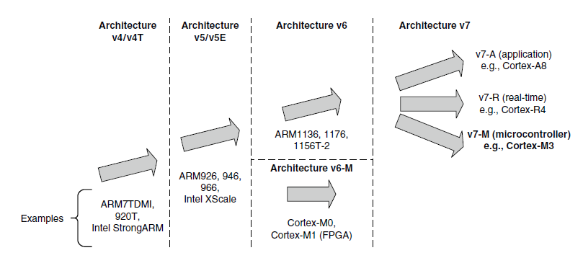
The Evolution of ARM Processor Architecture

Slide 11
ARM is the big player
ARM has a huge market share
As of 2011 ARM has chips in about 90% of the world’s mobile handsets
As of 2010 ARM has chips in 95% of the smartphone market, 10% of the notebook market
Expected to hit 40% of the notebook market in 2015.
Heavy use in general embedded systems.
Cheap to use
ARM appears to get an average of 8¢ per device (averaged over cheap and expensive chips).
Flexible
Spin your own designs.

Slide 12
Cortex-M3 Processor Applications
Low-cost microcontrollers:
The Cortex-M3 processor is ideally suited for low-cost microcontrollers, which are commonly used in consumer products, from toys to electrical appliances.
Automotive:
Another ideal application for the Cortex-M3 processor is in the automotive industry. The Cortex-M3 processor has very high-performance efficiency and low interrupt latency, allowing it to be used in real-time systems.
Data communications:
The processor’s low power and high efficiency, coupled with instructions in Thumb-2 for bit-field manipulation, make the Cortex-M3 ideal for many communications applications, such as Bluetooth and ZigBee.
Industrial control:
In industrial control applications, simplicity, fast response, and reliability are key factors.
Consumer products:
In many consumer products, a high-performance microprocessor (or several of them) is used.

Slide 13
Overview of the Cortex-M3

Slide 14
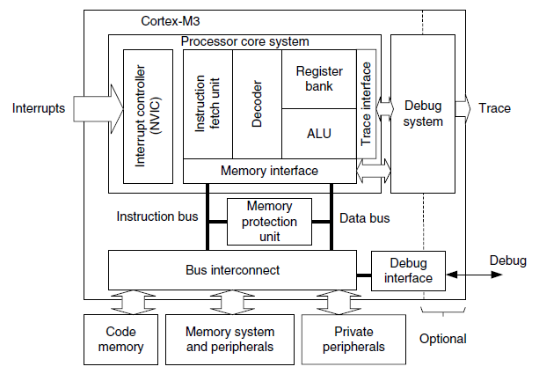
Fundamentals
A simplified view of the Cortex-M3
32-bit microprocessor

Slide 15
What Study with Cortex-M3
C
Assembly
Machine Code
Central
Processing
Unit
ISA
Software
Hardware
bl (interrupt)
ldr (read)
str (write)
System Buses
AHB/APB
Interrupts
GPIO/INT
Timers
USART
DAC/ADC
Internal &
External
Memory
Internal
External
Input
I2C
SPI
ADC
DAC
EMC
Output
Capture
UART
Interrupt
Compare

Slide 16
Fundamentals
Registers
Operation Modes
Built-in Nested Vectored Interrupt Controller
Memory Map
Bus Interface
Instruction Set
Interrupt and Exception

Slide 17
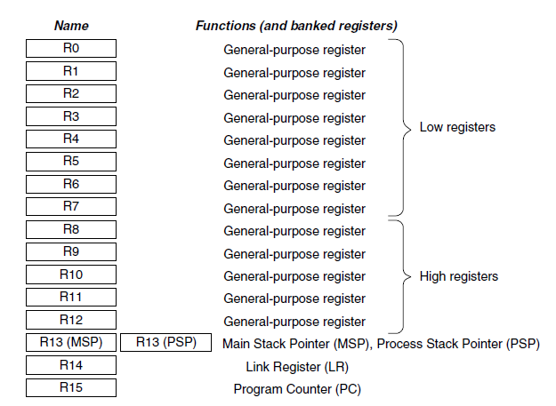
Registers
Cortex-M3 has registers R0 through R15

Slide 18
Registers
R0-R12:General Purpose Registers
R0–R12 are 32-bit general-purpose registers for data operations
The R0 through R7 general purpose registers are also called low registers
The R8 through R12 registers are also called high registers
R13: Stack Pointers
In the Cortex-M3 processor, there are two SPs.
This duality allows two separate stack memories to be set up.
Main Stack Pointer (MSP)
This is the default SP
used by the operating system (OS) kernel, exception handlers, and all application codes that require privileged access
Process Stack Pointer (PSP)
used by the base-level application code

Slide 19
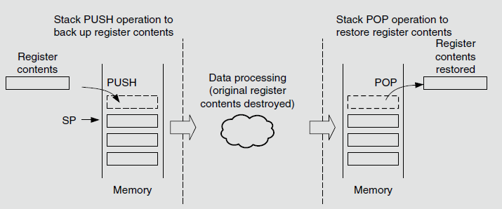
Registers
Stack PUSH and POP
It is simply part of the system memory, and a pointer register (inside the processor) is used to make it work as a first-in/last-out buffer.
The common use of a stack is to save register contents before some data processing and then restore those contents from the stack after the processing task is done

Slide 20
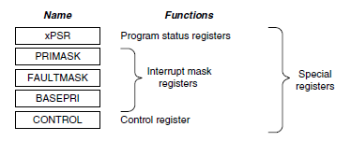
Registers
R14: The Link Register
When a subroutine is called, the return address is stored in the link register.
R15: The Program Counter
The program counter is the current program address.
Special Registers
Program Status registers (PSRs)
Interrupt Mask registers (PRIMASK, FAULTMASK, and BASEPRI)
Control register (CONTROL)

Slide 21
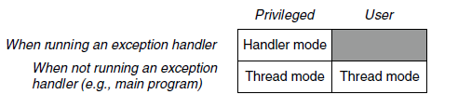
Operation Modes
The Cortex-M3 processor has two modes and two privilege levels
Thread mode and handler mode
The operation modes determine whether the processor is running a normal program or running an exception handler like an interrupt handler or system exception handler
When the processor is running a main program (thread mode), it can be either in a privileged state or a user state, but exception handlers can only be in a privileged state.

Slide 22
Interrupt Controller
Cortex-M3 processor includes an interrupt controller called the Nested Vectored Interrupt Controller (NVIC)
Features
Nested interrupt support
All the external interrupts and most of the system exceptions can be programmed to different priority levels.
When an interrupt occurs, the NVIC compares the priority of this interrupt to the current running priority level.
Vectored interrupt support
When an interrupt is accepted, the starting address of the interrupt service routine (ISR) is located from a vector table in memory.

Slide 23
Interrupt Controller
Features
Dynamic priority changes support
Priority levels of interrupts can be changed by software during run time.
Reduction of interrupt latency
Reduction of latency features such as automatic saving and restoring some register contents, reducing delay in switching from one ISR to another, and handling of late arrival interrupts.
Interrupt masking
Interrupts and system exceptions can be masked based on their priority level or masked completely using the interrupt masking registers

Slide 24
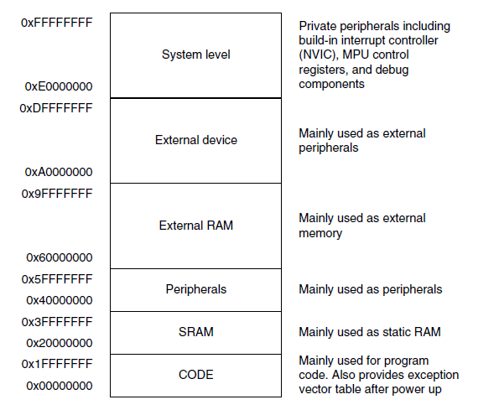
Memory Map
The Cortex-M3 has a predefined memory map
This allows the built-in peripherals, such as the interrupt controller and the debug components, to be accessed by simple memory access instructions.
Thus, most system features are accessible in C program code.

Slide 25
The Bus Interface
Several bus interfaces on the Cortex-M3 processor
Code memory buses
The code memory region access is carried out on the code memory buses
Two code memory buses: I-Code and D-Code
System bus
used to access memory and peripherals
Private peripheral bus
provides access to a part of the system-level memory dedicated to private peripherals, such as debugging components.

Slide 26
Instruction Set
In previous ARM processors, the CPU had two operation states: a 32-bit ARM state and a 16-bit Thumb state.
The Cortex-M3 supports the Thumb-2 instruction set.
It is now possible to handle all processing requirements in one operation state.
There is no need to switch between the two instruction sets
No need to separate ARM code and Thumb code source files, making software development and maintenance easier
It’s easier to get the best efficiency and performance, in turn making it easier to write software

Slide 27
Instruction Set
The Cortex-M3 processor has a number of interesting and powerful instructions
UFBX, BFI, and BFC
Bit field extract, insert, and clear instructions
UDIV and SDIV
Unsigned and signed divide instructions
WFE, WFI, and SEV
Wait-For-Event, Wait-For-Interrupts, and Send-Event
These allow the processor to enter sleep mode and to handle task synchronization on multiprocessor systems
MSR and MRS
Move to special register from general-purpose register and move special register to general-purpose register; for access to the special registers

Slide 28
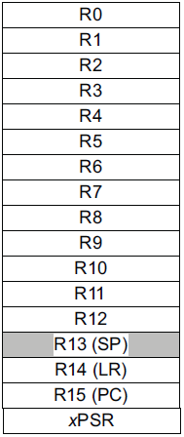
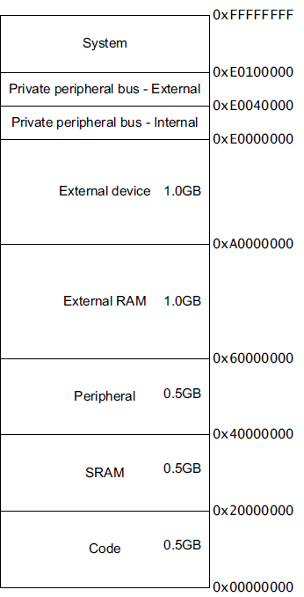
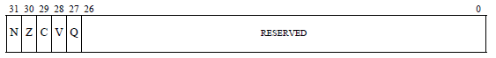
ARM Instruction Set Architecture
32-bits
32-bits
mov r0, #4
ldr r1, [r0,#8]
r1=mem((r0)+8)
bne loop
subs r2, #1
Endianess
Endianess

Slide 29
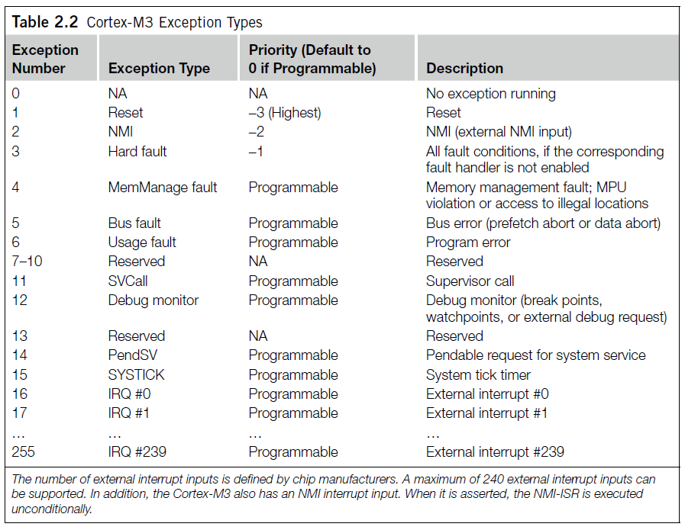
Interrupt and Exception
The Cortex-M3 processor implements a new exception model
a number of system exceptions plus a number of external Interrupt Request(IRQ)
no fast interrupt (FIQ)

Slide 30
Summary
Introduce basic computer architecture
Microprocessor & microcontroller
ARM process development
Basic of ARM Cortex-M3
Registers
Interrupt
Memory map
Instruction set

